Slide 1
Storyboards

Slide 2
Learning outcomes
What is a story
When to use a story
Pulling together your storyboard
When to present a story

Slide 3


Slide 4
The *magic* of story
A ‘good’ story is captivating
The audience need to remember your insights. A good story is always memorable.
Communicating using stories is as new as Homer.
A story has a beginning, middle and end

Slide 5
Story’s story
Beginning
Middle
End
Or setup…
You set the story and main elements: players, setting, desired outcomes, unresolved problem
You build the context for your audience.
Or conflict…
The longest section
Proposes solutions & alternatives
Gives examples
Improves on the context
Discusses pros and cons
Think about who your audience is. Why are they there?
Or resolution..
End with a clear plan of what is next.
What you propose and why.
Try to tie it back to the beginning

Slide 6
Scenario: Happy vets
Your local vet store is running a pet adoption scheme. The vet needs to increase pet adoptions, whilst need extra support from the local community centre. The vet organises a presentation to the local community to persuade them to allow the vet to arrange a pet adoption event free of charge during the summer.

Slide 7
Happy vets: Use the story’s elements
Plot
Rising Action
Climax
Falling action
Ending
Imagine… Sunshine, hot weather, children running around happily and we are running a pet adoption event in the local park.
But too few pets are adopted and it is cat litter season! The vet cannot give home to more animals, and many must go..
Too many animals are ending up strays on the streets! !
However, when we run the event near a playground, children go there and parents have the time they need to adopt more animals!
List of resources we need to run the scheme, showcasing the vital role of the playground, vet and location.
1
2
3
4
5

Slide 8

Narrative Structure
Spoken or written words
Tell the story in an order that makes sense
Gets people to pay attention

Slide 9
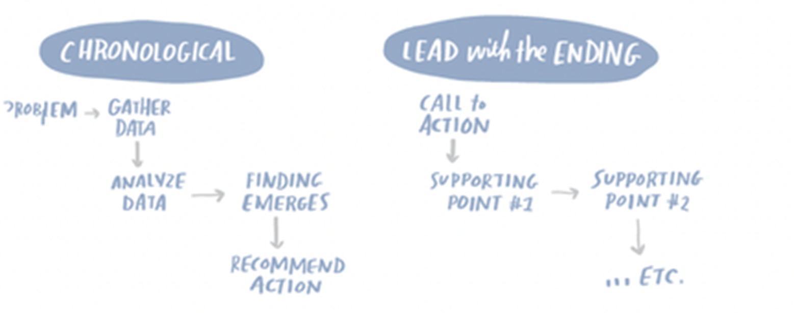
Narrative Flow
-the path that you take your audience

Slide 10

Spoken or Written
--What role will your audience play?

Slide 11
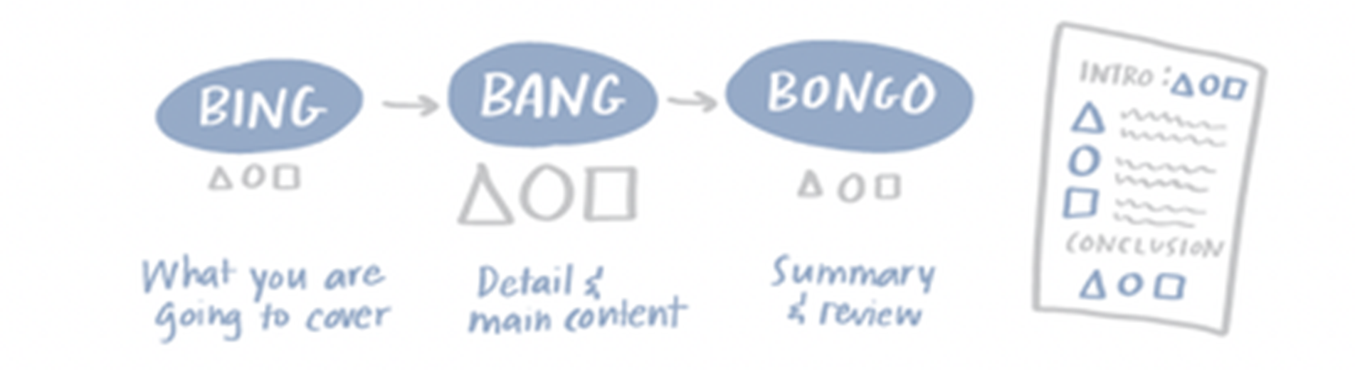
Repetition

Slide 12
We all learn by … repetition!
Repeat information enough, and people will remember.
So when you present, tell your audience about what you are going to tell them.
Then discuss it with them
And conclude by summarising what you just told them
Notes:
Helps move things from short-term to long-term memory

Slide 13
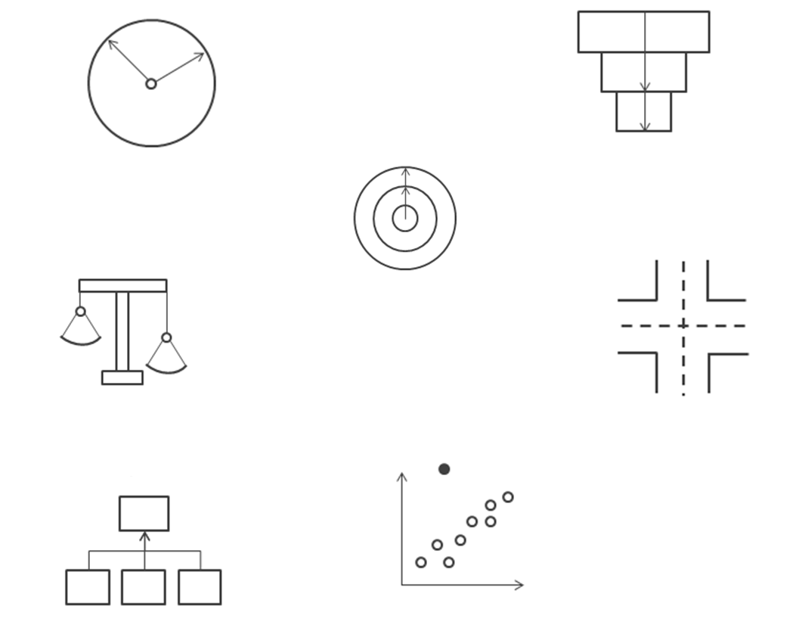
Seven Types of Data Stories
Change over time
Drill Down
Zoom Out
Contrast
Intersections
Factors
Outliers
Notes:
https://help.tableau.com/current/pro/desktop/en-us/story_best_practices.htm

Slide 14
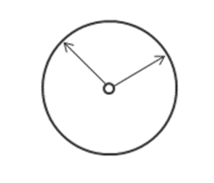
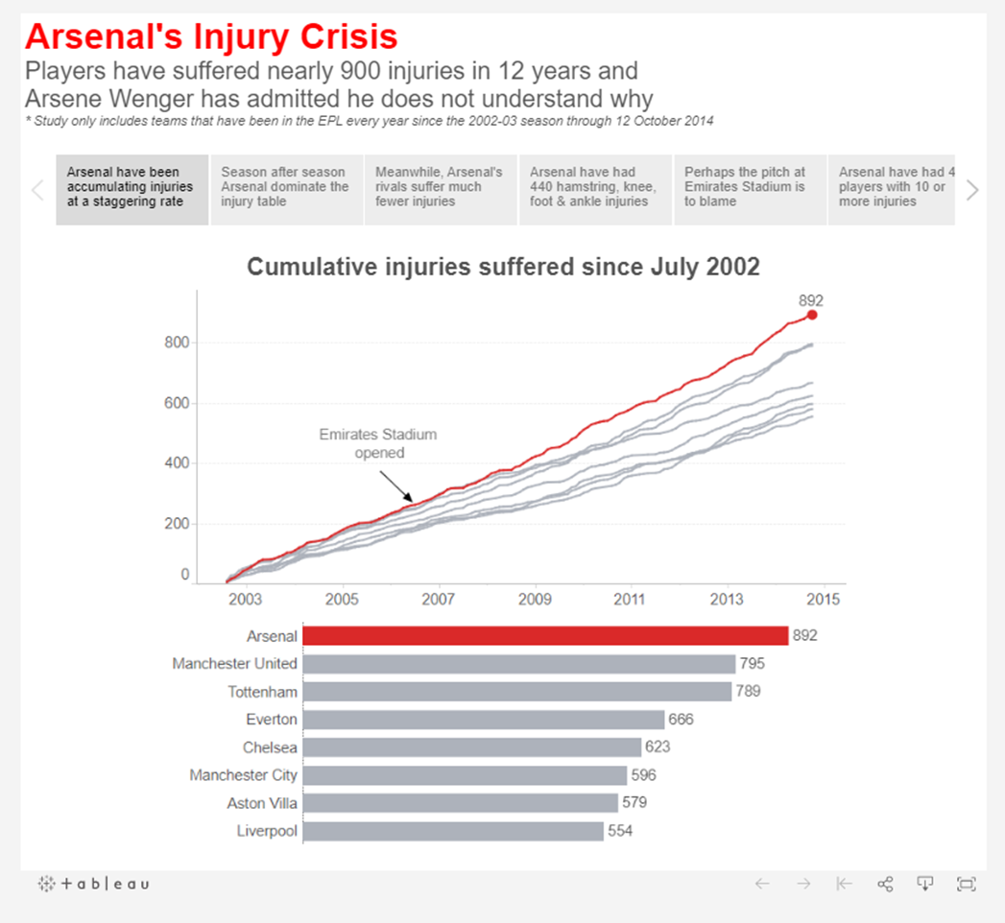
Change Over Time
Notes:
https://public.tableau.com/en-us/gallery/arsenal-injury-crisis?_fsi=RZSnCi5L
What it does: Uses a chronology to illustrate a trend.
Discussions it starts: Why did this happen, or why does it keep happening? What can we do prevent or make this happen?
Have students visit examples and get an introduction to story points

Slide 15
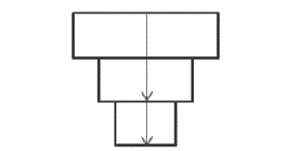
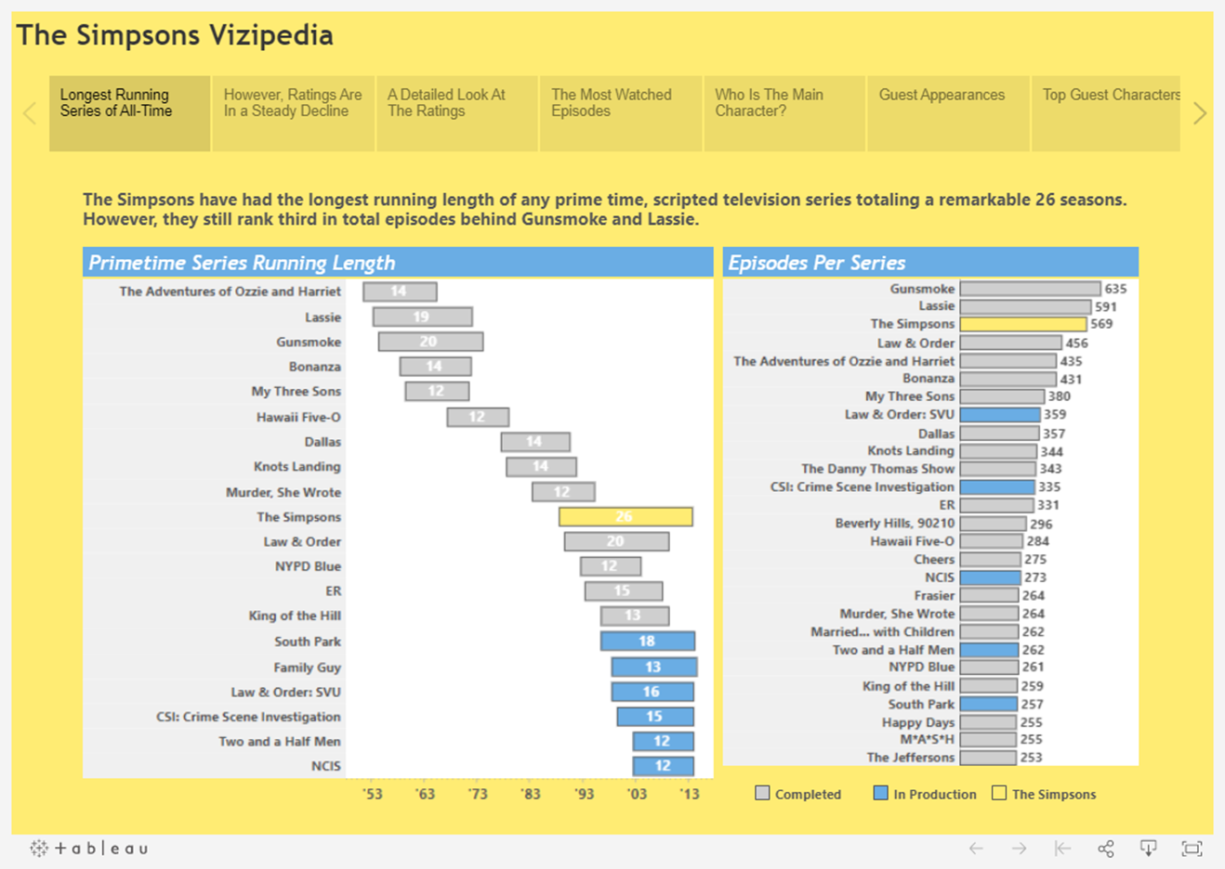
Drill Down
Notes:
What it does: Sets context so that your audience better understands what's going on in a particular category.
Discussions it starts: Why is this person, place or thing different? How does the performance of this person, place, or thing compare?
Examples: Tell Me About Will: https://public.tableau.com/en-us/gallery/tell-me-about-will?_fsi=RZSnCi5L
, The Simpsons Vizipedia: https://public.tableau.com/en-us/gallery/visualizing-simpsons?_fsi=RZSnCi5L

Slide 16
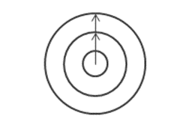

Zoom Out
Notes:
What it does: Describes how something your audience cares about relates to the bigger picture.
Discussion it starts: How does something you care about compare to the bigger picture? What effect does one area have on the bigger picture?
Example: Vancouver Cyclists: https://public.tableau.com/en-us/gallery/vancouver-cyclists?_fsi=RZSnCi5L

Slide 17
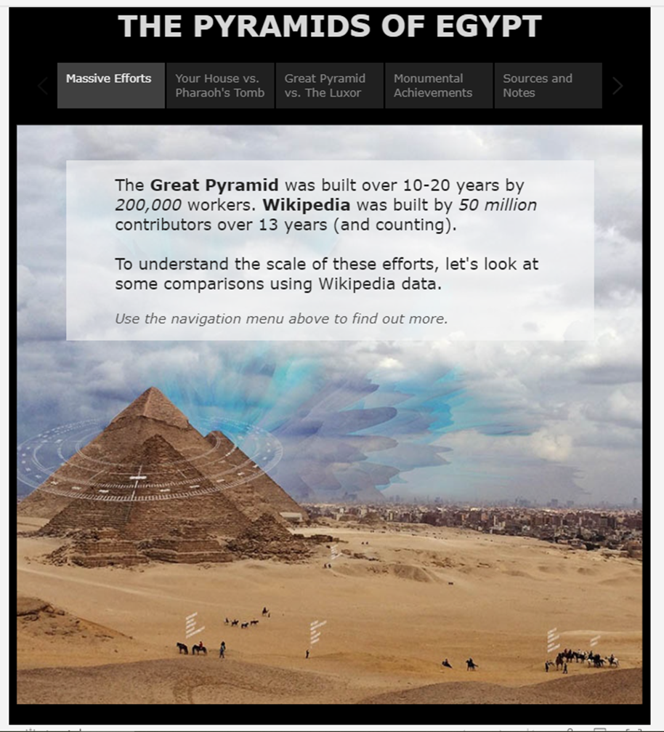
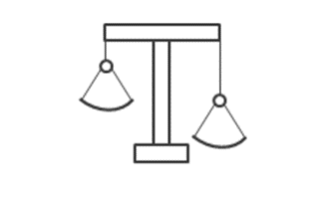
Contrast
Notes:
What it does: Shows how two or more subjects differ.
Discussions it starts: Why are these items different? How can we make A perform like B? Which area should we focus on and which area is doing fine?
Example: The Pyramids of Egypt: https://public.tableau.com/en-us/gallery/pyramids-egypt?_fsi=RZSnCi5L

Slide 18
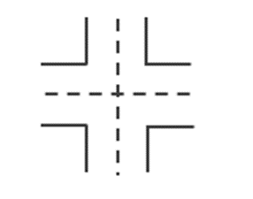
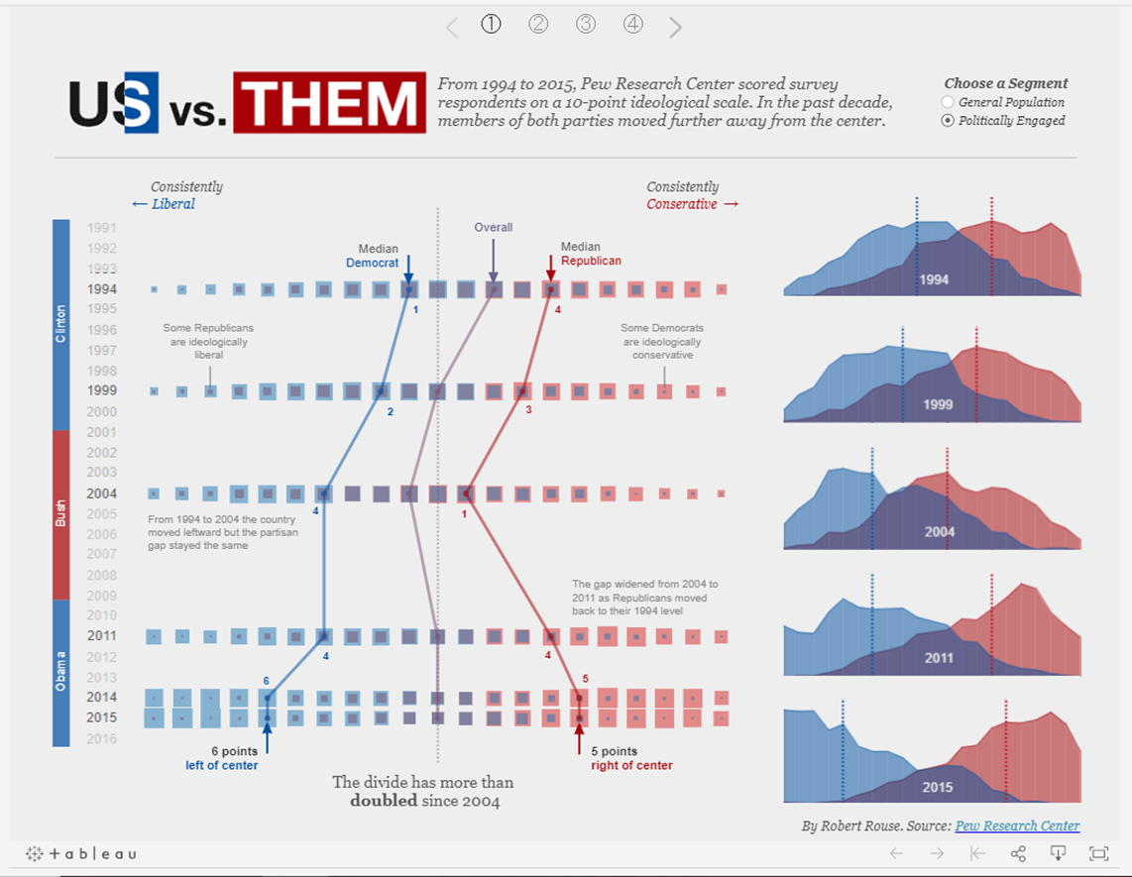
Intersections
Notes:
What it does: Highlights important shifts when one category overtakes another.
Discussions it starts: What causes these shifts? Are these shifts good or bad? How do these shifts affect other aspects of our plan?
Example: US vs. THEM: https://public.tableau.com/en-us/gallery/political-polarization-us?_fsi=RZSnCi5L

Slide 19
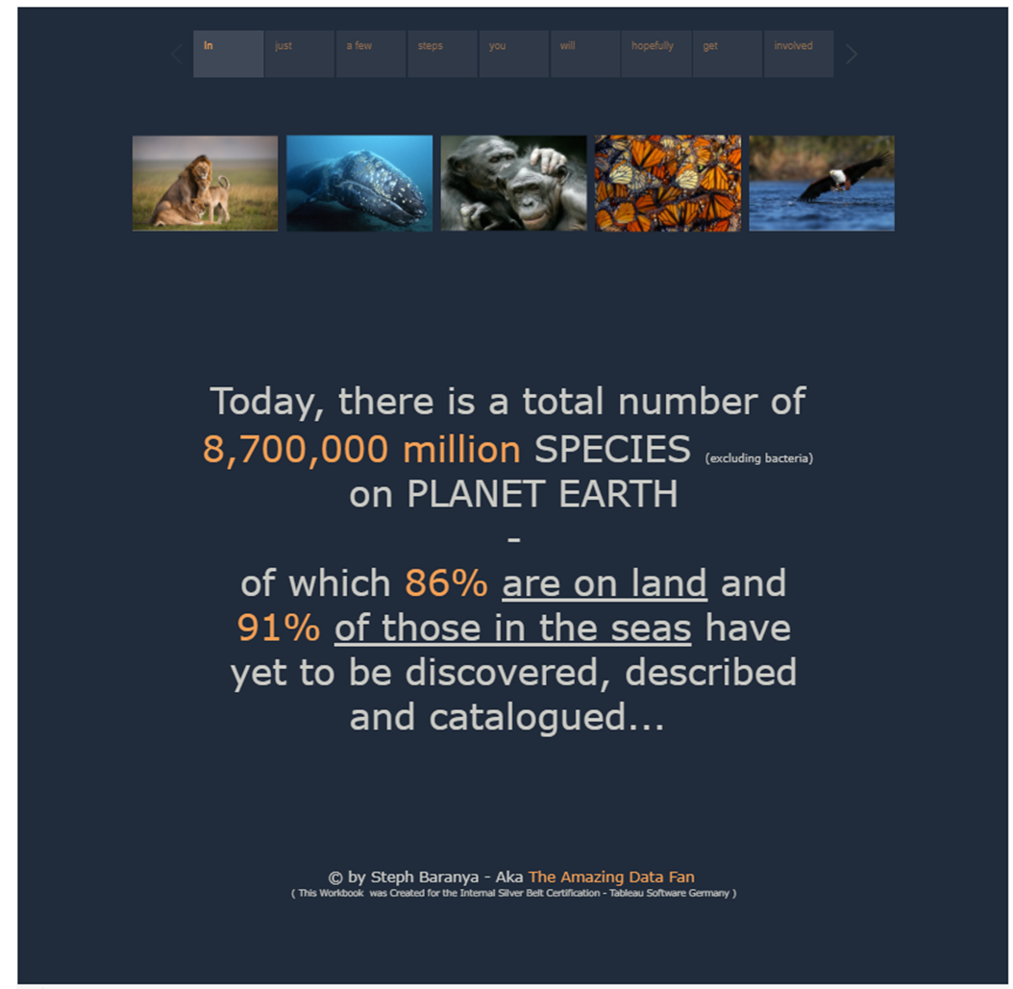
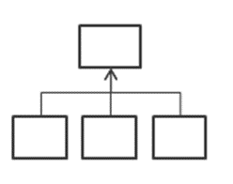
Factors
Notes:
What it does: Explains a subject by dividing it into types or categories.
Discussions it starts: Is there a particular category we should focus on more? How much do these items affect the metric we care about?
Example: Planet Earth: https://public.tableau.com/profile/steph.baranya?_fsi=RZSnCi5L#!/vizhome/PlanetEarth___/Injustafewstepsyouwillhopefullygetinvolved

Slide 20
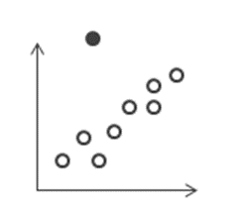
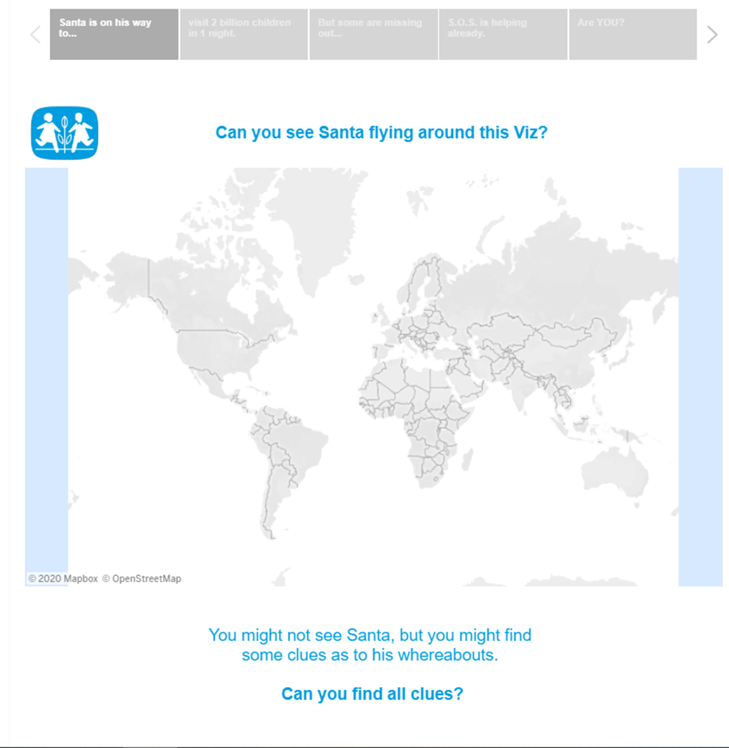
Outliers
Notes:
What it does: Shows anomalies or where things are exceptionally different.
Discussions it starts: Why is this item different?
Example: SOS Children's Villages: https://public.tableau.com/profile/steph.baranya?_fsi=RZSnCi5L#!/vizhome/PlanetEarth___/Injustafewstepsyouwillhopefullygetinvolved

Slide 21
Storyboard in Flourish
Go to this link or the URL in moodle that is named create a story with Flourish.

